Slide 1
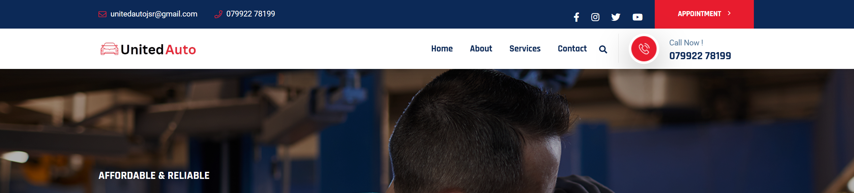
HOME, SERVICE, ROAD SERVICE, BREAKDOWN, INSURANCE,PRICING, CONTACT
SERVICE
MECHANICAL
BODY
VALUE ADDED SERVICE
CAR DETAILING
MECHANICAL
TYPES OF MECHANICAL WORK DONE IN OUR OFFICE
Engine Repair
Suspension
Electrical
Brake
Clutch
Gear box
AC
EV CAR
Periodic Maintenance

Slide 2
BODY
DENTING
PAINTING
TOUCHUP PAINTING
ACCIDENTAL REPAIR
DENTING (INFO)
TO REPAIR DENTING WE USE A DENT PULLER AND PROFESSIONAL TOOLS AND METHODS.
PAINTING (INF0)
DUST FREE PAINT BBTH WITH HEATH CHAMBER WITH PROFFESIONAL PAINT GUN AND HIGH QUALITY PAINT
TOCHUP PAINTING (INF0)
FOR TOUCHUP PURPOSE AND LOW COST PAINTING
ACCIDENTAL REPAIR (INF0)
WE PROVIDE CASHLESS SETLMENTS WITH INSURANCE
BY DIRECT SETLMENT WITH COMPETATIVE RATE

Slide 3
VALUE ADDED SERVICE
RUBBING
POLISH
ANTIRUST
CERAMIC COATING
P.P.F COATING
INSURANCE SERVICE
INSURANCE CLAIM
INSURANCE RENEWAL
INSURANCE CLAIM PARTNER
SBI GENERAL
ROYAL SUNDARAM
LIBERTY
GO DIGIT
NATIONAL INSURANCE
KOTAK
FUTURE
RELIANCE
UNIVERSAL SOMPO
HDFC ERGO
ORIENTAL
CHOLA MS
MAGMA
BHARTI
ACCO
BAJAJ ALIANCE
NEW INDIA
TATA AIG
INSURANCE RENEWAL
TATA AIG
SBI GENERAL

Slide 4
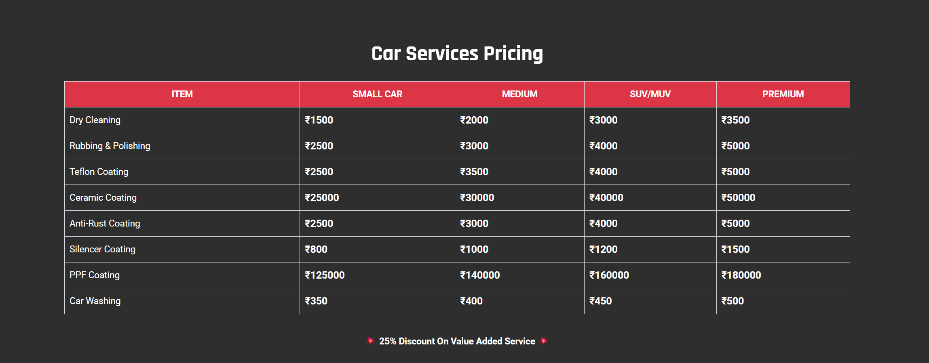
*NOT TO BE DISPLAYED DIRECTLY ON THE HOME PAGE, WILL BE DISPLAYED WITH THE SUITABLE OPTION FROM THE ABOVE

Slide 5
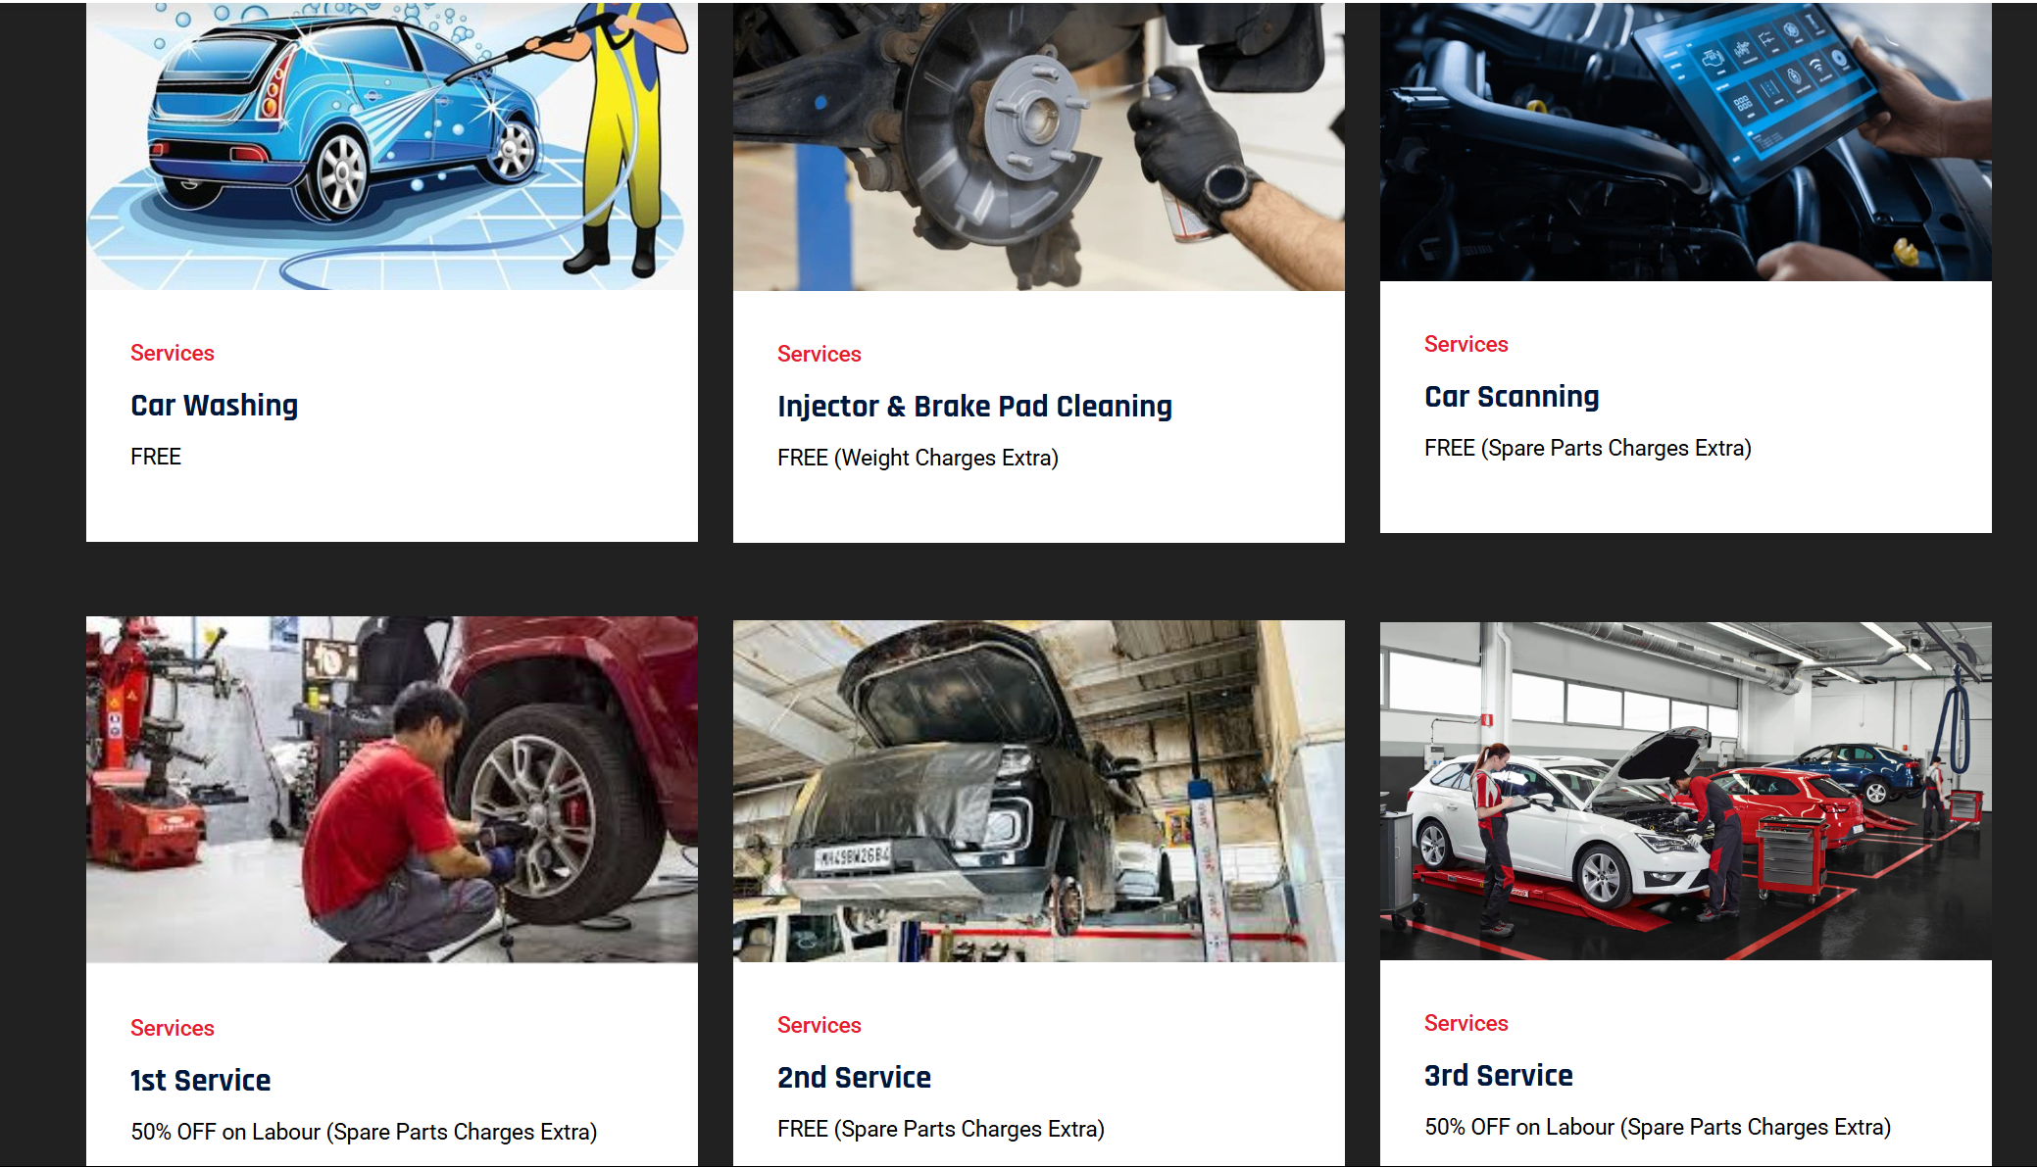
MECHANICAL SERVICE
INSURANCE SERVICE
BODY SERVICE
VALUE ADDED SERVICE
CAR DETAILING
SUBSCRIPTION SERVICE

Slide 6
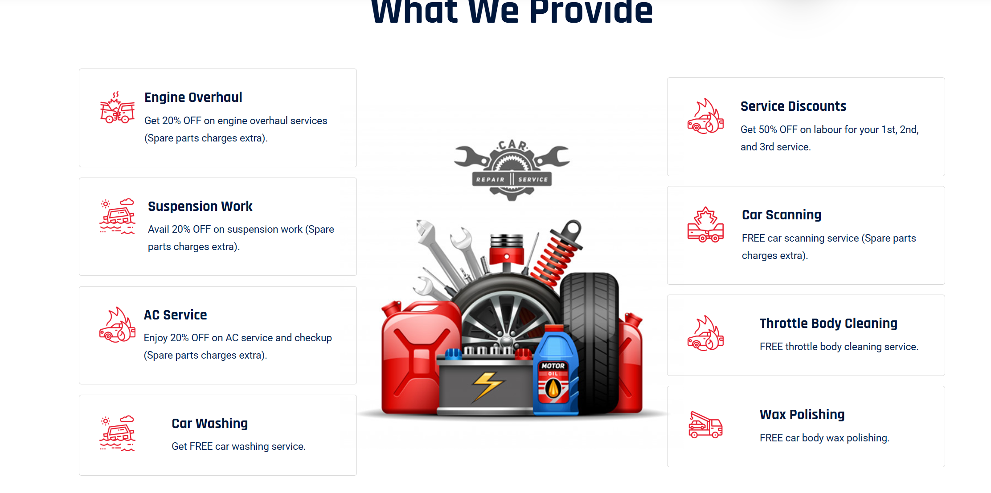
*CHANGE OF LOGO WITH SUITABLE LOGO

Slide 7
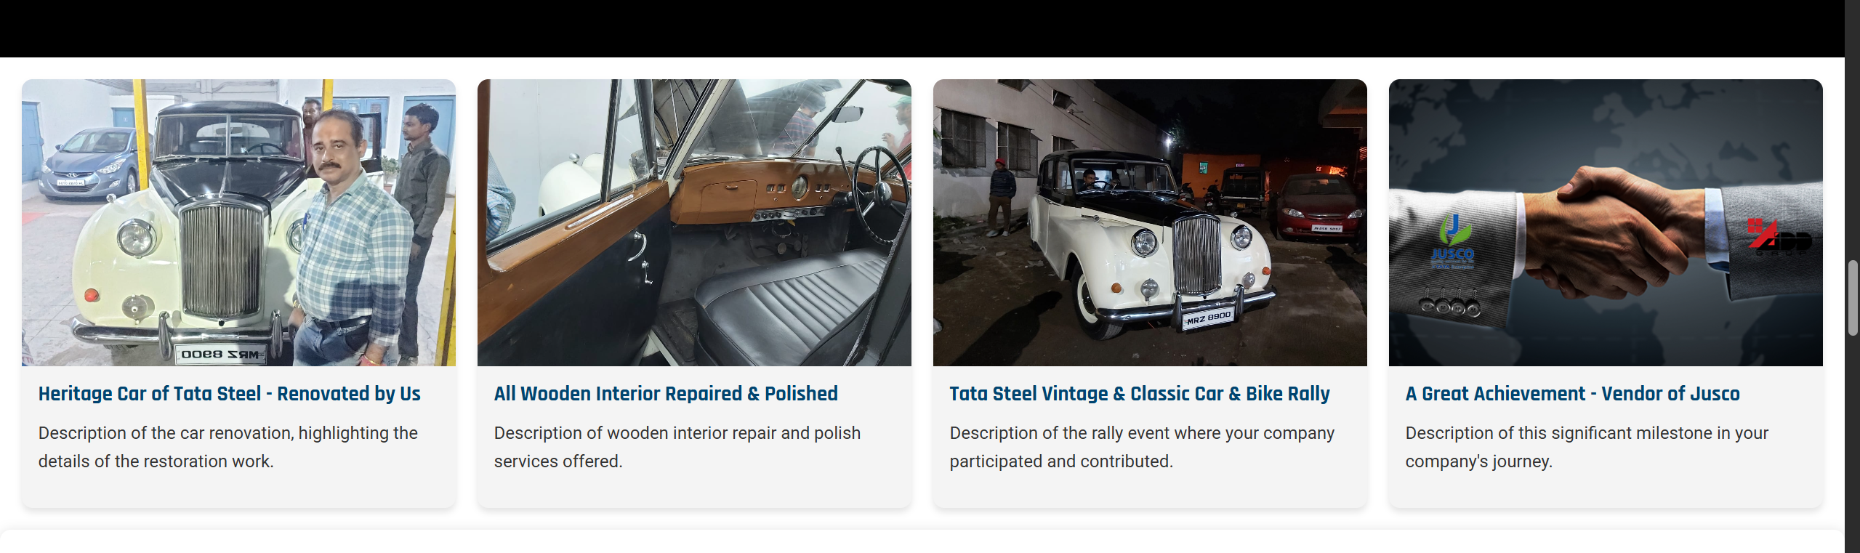
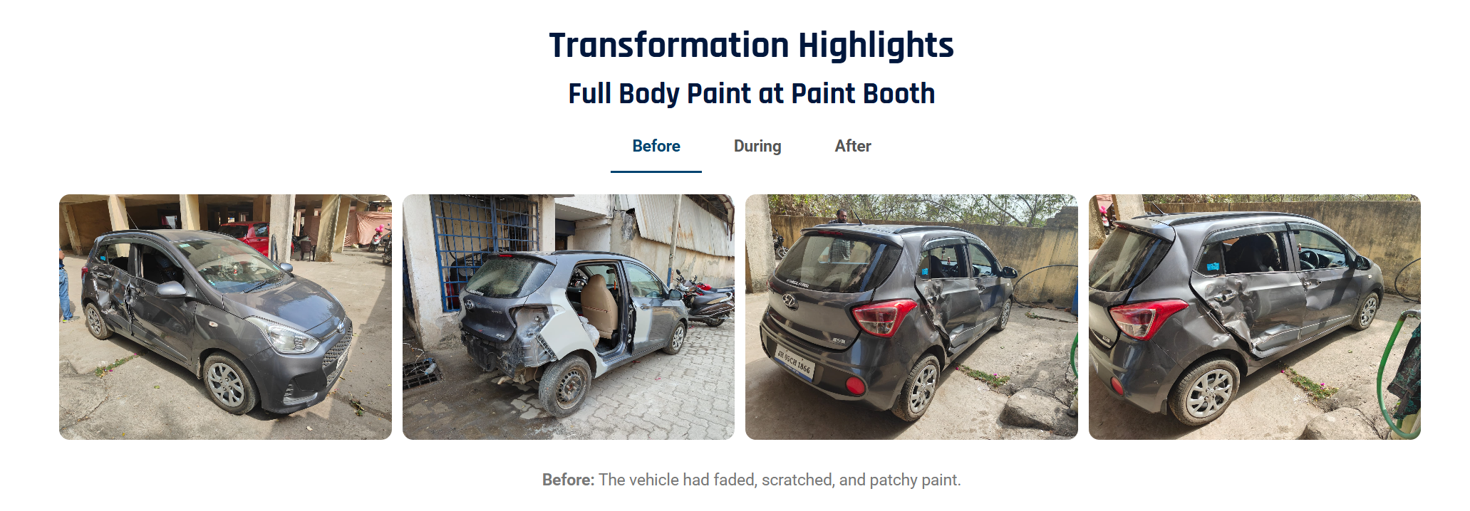
*NEED SOME VARIETY OF IMAGE WITH LUXUARY CARS
THE IMAGES WILL BE PROVIDED
*BETTER WAY TO SHOW TRANSFORMATION
AS DISCUSSED

Slide 8


*TO BE CHANGED INTO SOMETHING LIKE THE BELOW PICTURE

Slide 9
Serviceable Brand
Serviceable Brand
MARUTI
HYUNDAI
TATA MOTORS
MAHINDRA
TOYOTA
Ford
Fiat
Jeep
Serviceable Brand
Chevrolet
Honda
Skoda
VW
Renault
Marcedes
Audi
BMW
Mitsubishi
It should be appeared before Home and all the brands in Drop Down under Serviceable Brand.
You can suggest any suitable word also for “Serviceable brand”

Slide 10
Offers
We can introduce our printed card under offer. I have already shared you the card previously.
Road Assistance for break down to any customer within a range of 25 km from our workshop. Workshop Location in google map with address to be delivered to customer who wants to avail the road side assistance.
*Terms & Conditions are applicable. (We will provide details)

